Slide 1
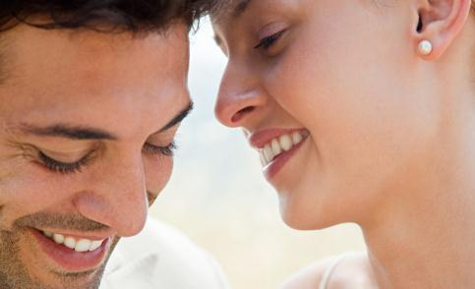
Problem Solving & Decision Making
NOTE:
To change images on this slide, select a picture and delete it. Then click the Insert Picture icon
in the placeholder to insert your own image.
Aundranikki Jones
Natasha Higdon
Tameka Kendrick
Cognitive Psychology 360
Janel Fairchild

Slide 2
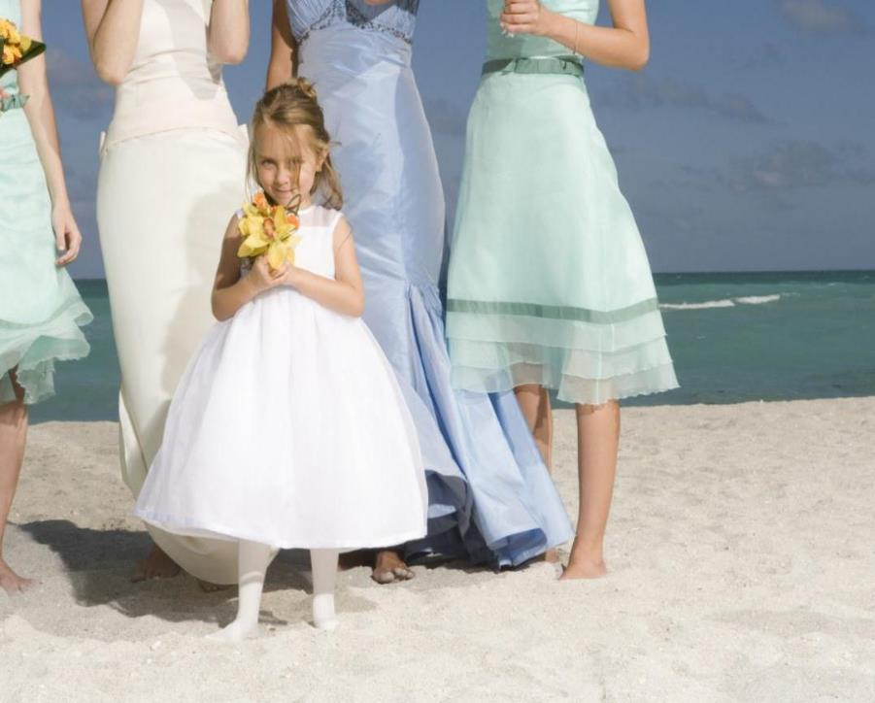
Two Brides/Two Weddings
NOTE:
To change images on this slide, select a picture and delete it. Then click the Insert Picture icon
in the placeholder to insert your own image.
Our wedding planning team has been given the honor to select an amazing venue for two weddings, as well as selecting the floral arrangements for the beautiful brides.
For Bride 1, we will go with the Old Magnolia Mound Plantation for her venue and her floral arrangement will consist of sunflowers with hints of teal and crystal.
Bride 2, will have her nuptials performed at Parc 22, a popular venue for wedding, corporate meetings, and other formal gatherings. Her floral arrangement will have red roses, soft white petals, and touches of gold.

Slide 3
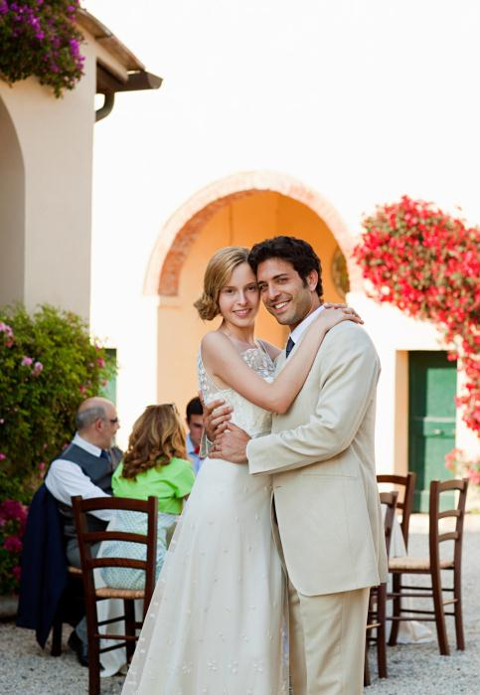
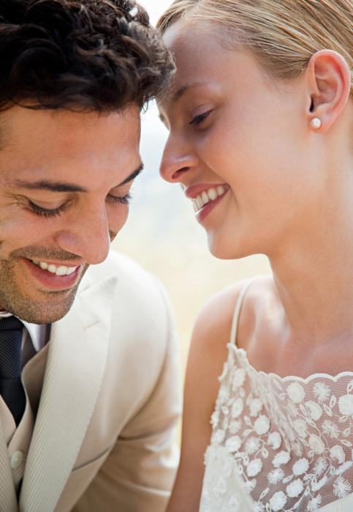
Two pictures with caption layout
NOTE:
To change images on this slide, select a picture and delete it. Then click the Insert Picture icon
in the placeholder to insert your own image.
Caption

Slide 4
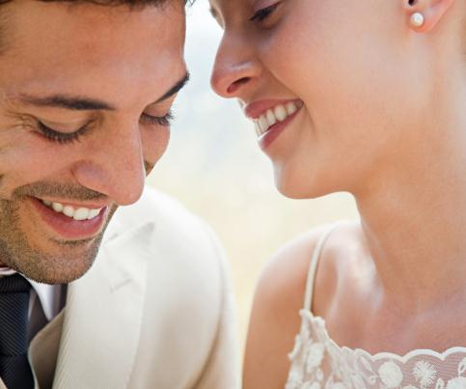
The Emotional and Cultural Effect
NOTE:
To change images on this slide, select a picture and delete it. Then click the Insert Picture icon
in the placeholder to insert your own image.
Bride 2
  Our wedding planning team consists
  Of three well trained ladies, each
  with unique creativity.
  Bride 1, is a young southern bride
  from South Carolina with
  lots of southern charm.
Bride 2, is a young career driven woman who desires a formal wedding.
Notes:
Bride 1- Our bride knew she wanted a nice traditional wedding but was unsure of how to create the effect. Our staff had to call on our directed remembering to create the memorable moment of a lifetime. Karen, Bride 1, had to incorporate old traditional elements to the wedding because she had a good bit of older guests. For our staff, we had to do a lot of noticing and adding much of our energy and personal emotion into the planning and organization of every detail of the placement of all items. The amount of critical thinking that has gone into this project is overwhelming.
Bride 2, Kathy, lives a very elegant and conservative lifestyle. Her guest list includes colleagues and superiors so she feels strongly about the wedding being flawless. Our staff is feeling the pressure of incorporating a Hawaiian cultural theme into an elegant wedding.

Slide 5
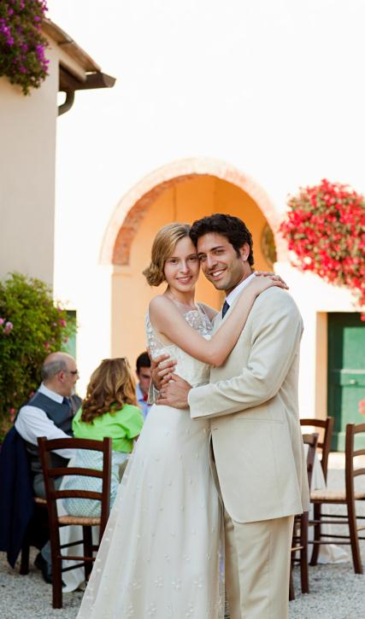
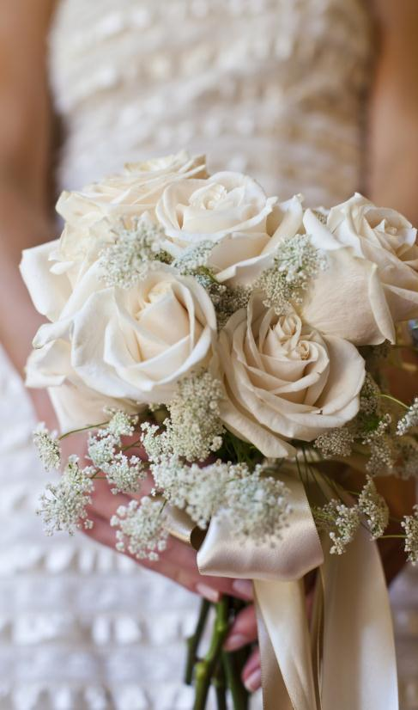
Perception, Attention, Memory, and Language
NOTE:
To change images on this slide, select a picture and delete it. Then click the Insert Picture icon
in the placeholder to insert your own image.
Miss Karen
During the preparation Miss Karen’s wedding, all of the staff members had to call on their visions of what Karen’s southern wedding should look like.
We each had some type of creative experience that cued our memory, telling how each detail should go.
Although we have a layout drawn up of the wedding, paying extra careful to the small details, we have to utilize our memories as a backup plan.
Miss Kathy
In order to create Kathy’s vision, our staff had to gain a good perception of what Hawaiian elegance was.
Notes:
Karen- Come wedding day, we use many tools and resources to make the bride’s vision come together, including our everyday reasoning. Using everyday reasoning utilizes our own judgments and knowledge of things we already know. It saves us valuable time. We maintain the information about Karen’s wedding in our long-term memory to ensure she has the wedding of her dreams.
Kathy- Once we all created a similar visual, we were able to begin planning. All of our attention was put into this wedding. We had to give attention to large and small details, memorizing each as we go.

Slide 6
The Role of Inductive and Deductive reasoning
Bride 1 Problem: Finding a venue large enough to accommodate her 100 guest and that will work well with her personal style of southern charm.
Notes:
In order to find the perfect venue for our bride the team used some specific reasoning skills. We used inductive reasoning which reasons things from specific to general. We know that our brides’ style is southern charm. We know that the Old Magnolia Mound is a plantation, therefor we conclude that it has southern charm. We cannot be completely certain if this venue is our brides’ idea of southern charm but we do have strong confidence that this plantation is what she has envisioned for her wedding. We know that plantations are southern but this is not necessarily true of the Old Magnolia Mound Plantation. These are all factors of inductive reasoning. We also used deductive reasoning in picking this venue which reason from general to specific. We know that the Old Magnolia Mound Plantation has a ball room that can accommodate 200 people therefor 100 guest can be accommodated. This information is deductively valid, that is the premise that it accommodate 200 people is true therefore our conclusion that it will hold our 100 guest in definatly true.

Slide 7
Problem Solving
Bride 2 desires a very formal affair . She wants everything to be elegant and refined. She is in love with the venue and the decor that we have chosen for her event. The problem that this bride faces is that she does not want any children at her wedding. She wants us to figure out how to convey this to her guests without anyone getting offended or people having to leave their young children at home.
Solution: We will have the ushers to seat guests with children towards the back of the venue. We would ask parents to please take their children out if they become noisy.
Notes:
We consider this a means to an ends analysis. We compared the goals handling the issue of children at the ceremony without being offensive to guests. Possible ways that we could handle this issue is by telling guests no children allowed which may cause some guests not to come. So we considered the seating option as the best option to keep the bride and the guests happy.

